Slide 1
by :canster mendonca
m

Slide 2
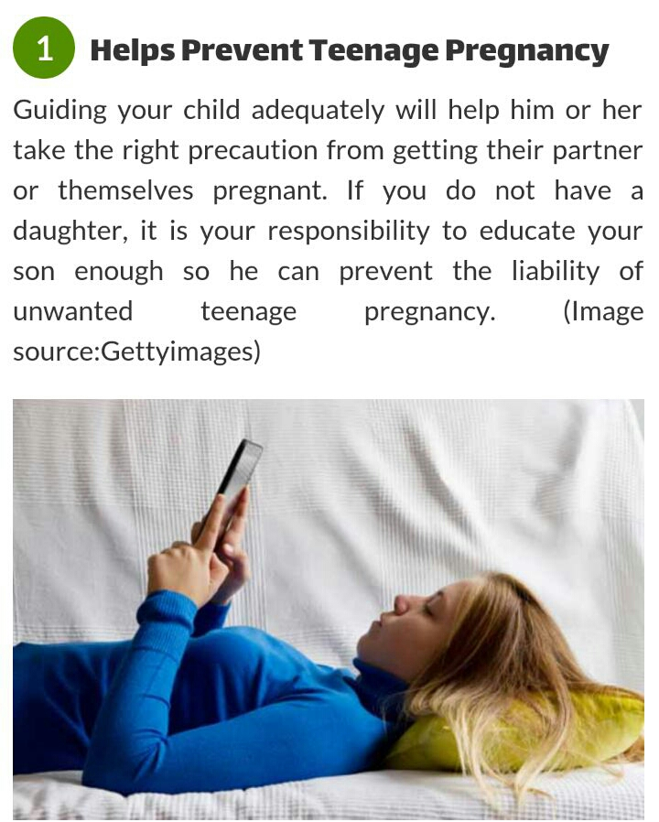

Slide 3
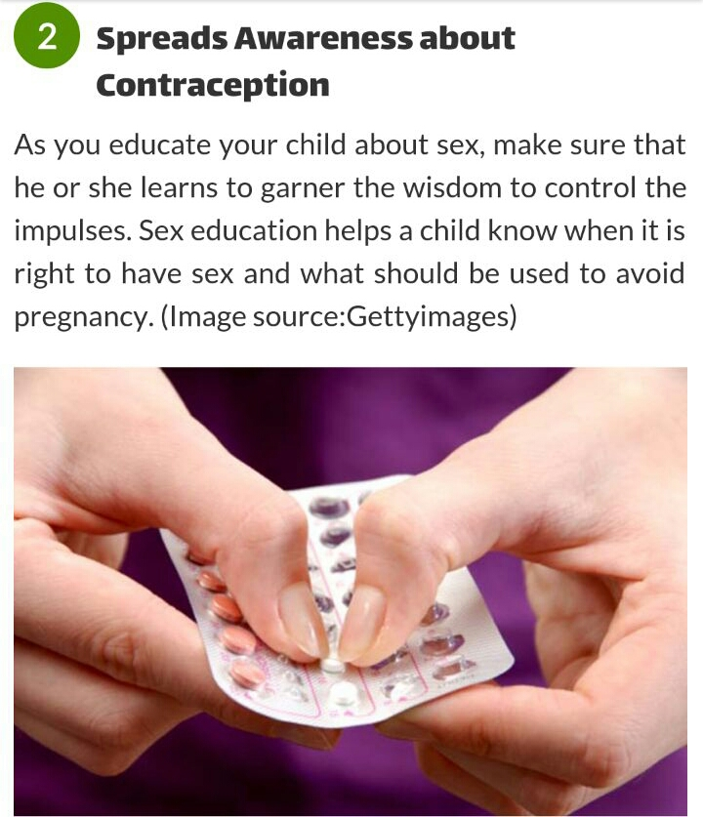

Slide 4
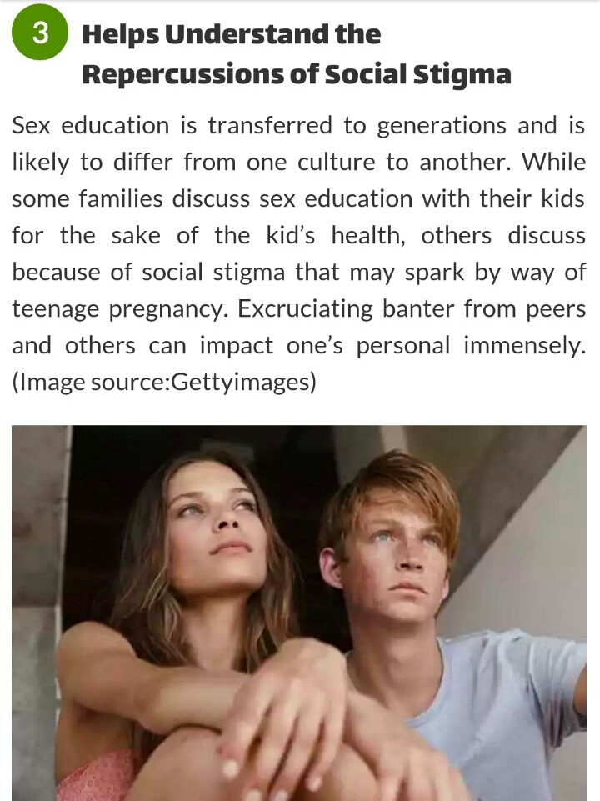

Slide 5
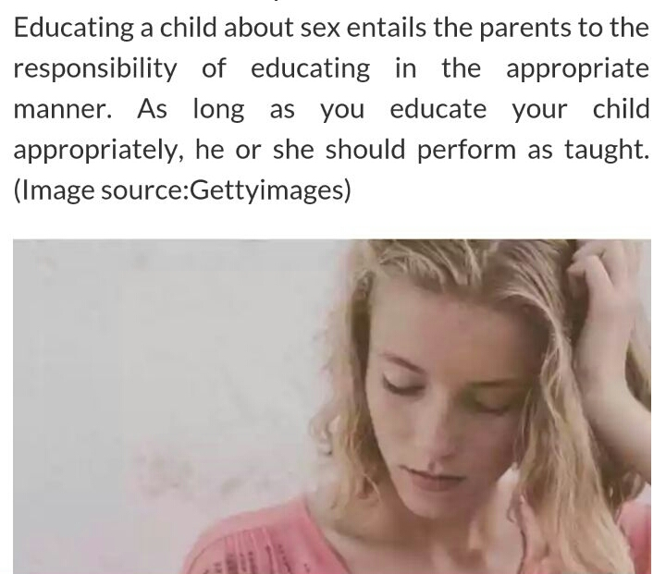
4. Reveals the Consequences of unsafe sex

Slide 6
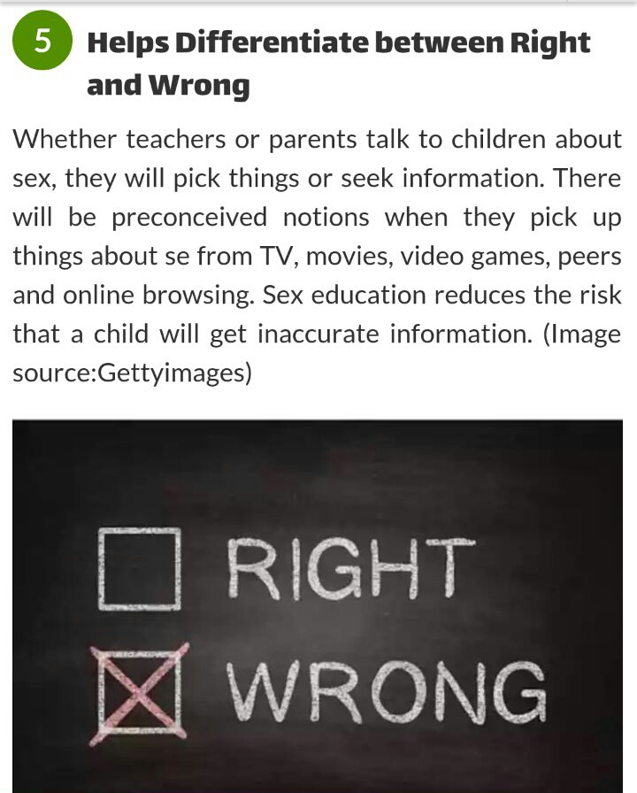

Slide 7
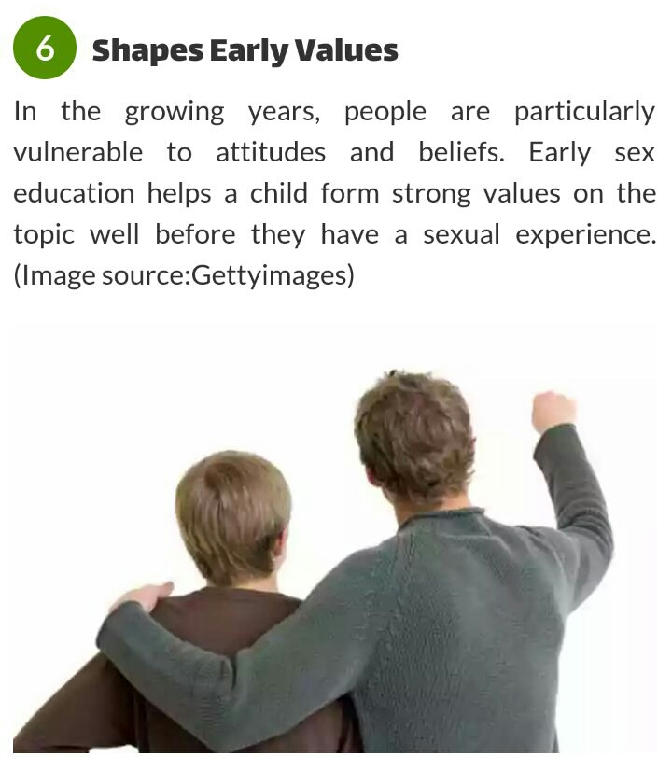

Slide 8
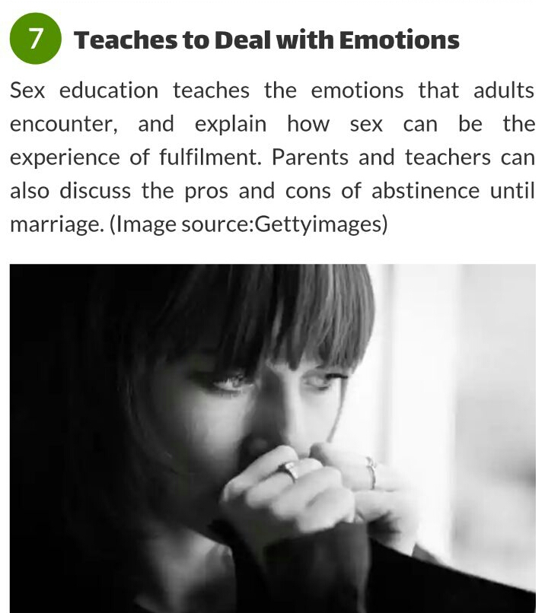

Slide 9
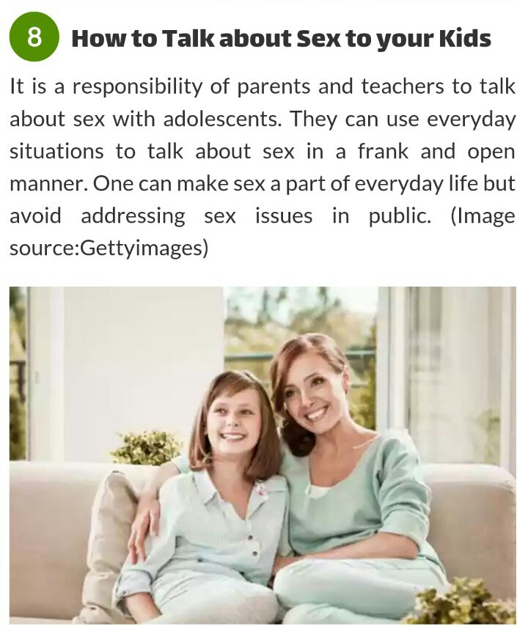

Slide 10
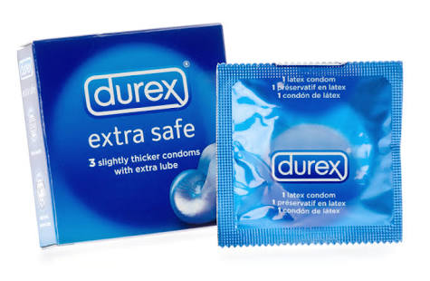
9. Use of Protection.

Slide 11
10. Respecting Personal Boundaries.

Slide 12
THANK YOU!!

