Slide 1
By: Sharan D’sa
3rd Bcom A
155430376

Slide 2
Reliance is a Holding company
Its headquarters is located in Mumbai
It is the most profitable company in India
With earnings of more than 300 billion dollars and assets of 7000 billion dollars, its pays for 5% of India's income tax

Slide 3
CCEICEO of Reliance Industries Ltd

Slide 4
Jio
Jio is a mobile network operator in India
Reliance Jio’s official name is ‘Reliance Jio Infocomm Limited’ (RJIL)
It provides wireless 4G service network
It is owned by ‘Reliance Industries Ltd’ It was incorporated in 2007 and is based in Mumbai, India

Slide 5
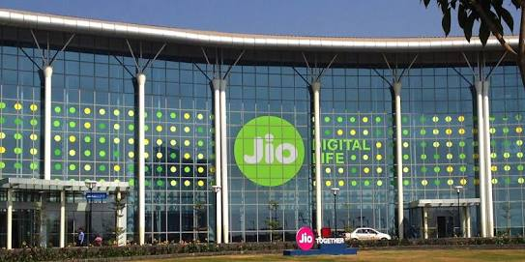

Slide 8
Digital Vision

Slide 9
Digital
Revolution
India is going Digital
It need Digital tools and skills
India cannot be left behind
India is ranked 155th of 230 countries
Jio will help take India to the one of the top 10 spots globally.

Slide 10
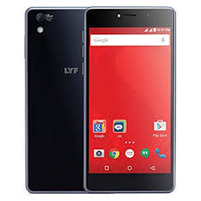
Products and Services
Jio LYF
JioFi

Slide 14
Brand ambassador - Shah Rukh Khan
Initially it was distributed for FREE
Packages were cheaper than the competitors

Slide 15
Special discounts for the students
Lifetime free voice calls and messages
Aadar-based activation
Best network with lowest data rates globally

Slide 16
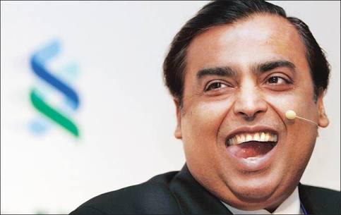
Thank
you
Thank
You
Ja Beta, Apni Zindagi

