Slide 1
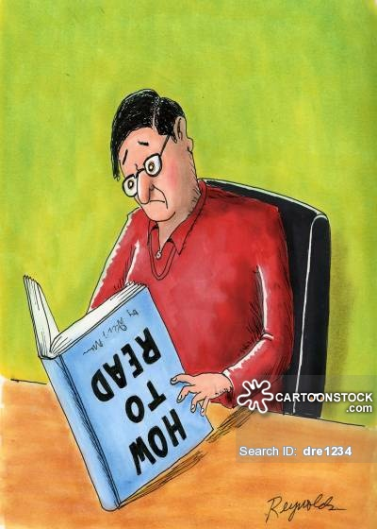

Slide 2
ILLITERACY

Slide 4
Meaning of illiteracy
Illiteracy is a state whereby one is unable to read & write. In its simplest form, it can be defined as lack of any or sufficient education.
Sometimes people who have had very basic education also experience challenges in reading & writing

Slide 5
Challenges of illiteracy cut across
Gender
Age
Race
Geographical location
Cultures

Slide 6
Causes of illiteracy
Illiteracy among parents
Lack of family support
Unemployment of the education
Lack of awareness
Social barriers
Lack of affordable education facilities
Poverty

Slide 7
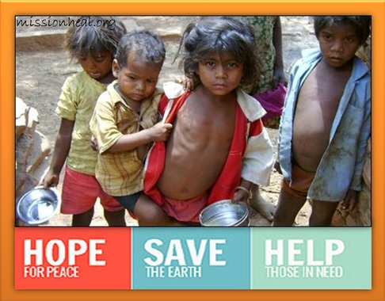

Slide 8
Consequences & effects of illiteracy
Poverty
Child marriage
Difficult life
Social crimes
Hinders economic & social progress
Underpayment
Intergenerational illiteracy

Slide 9
Possible solutions to stop or control illiteracy
Free education
Awareness
Grants
Late night classes
Free books
Digitization
Lower education costs

Slide 10
Conclusion
The value of education cannot be underestimated. Illiteracy, therefore, has no room in the modern society. Everyone should aspire to be educated and gain knowledge because of the important benefits of being literate. If all are literate it reduces fraudlant and misuse of people.

Slide 11
THANK YOU
Submitted by
Poojashree and Melita

